Slide 1

OpusCOMMS
project management system

Slide 2
Problems with the Current System
Usability is very low
Separate internal and external sites
Contains bugs
Hasn’t been maintained

Slide 3
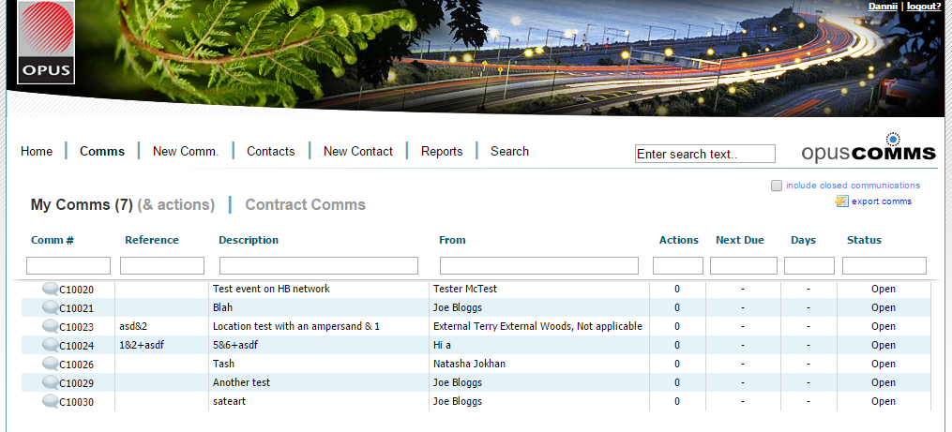

Slide 4
Project Goals
Create a single OpusCOMMS system
Create a new database
Incorporate user experience
Be user-friendly
Create more intuitive processes than the current system

Slide 5
Related Work/Design Inspiration
User Experience
  Haberburch’s six user experience strategies
  Nielson’s ten heuristics
Websites awarded the Best User Experience
Available job logging sites
User feedback
Opus’s online websites

Slide 6
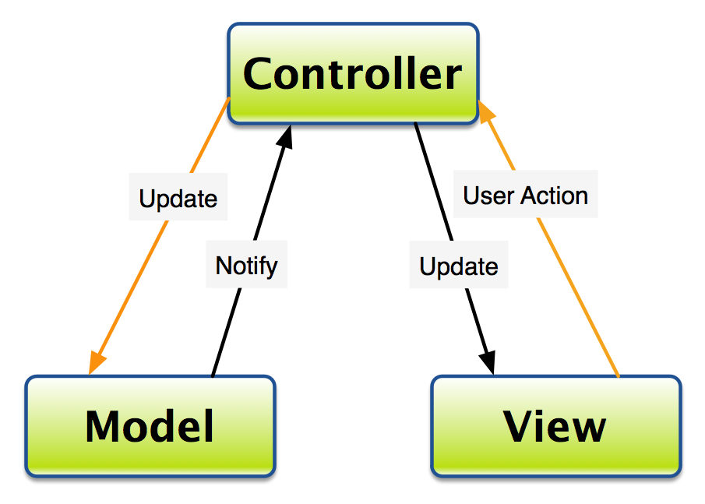
MVC
Model
  Data
View
  Presentation and visuals
Controller
  Receive input, interpret and validate.
  Updates the View and Model
  Application logic
Image Source: https://developer.chrome.com/apps/app_frameworks

Slide 7






Other Used Technologies
Notes:
Talk about designing the Database – agile approach so added to it over time.

Slide 8
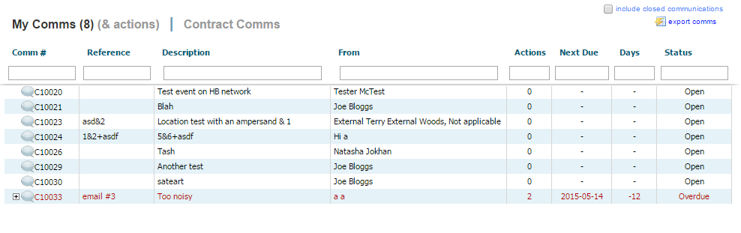
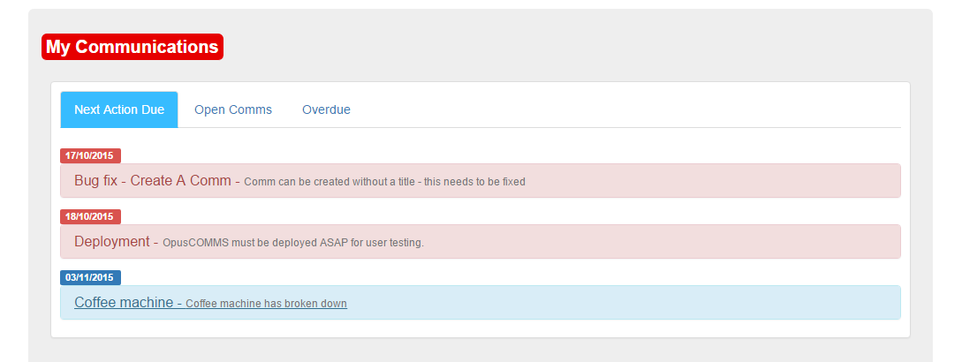
Original System vs Now

Slide 9
Demo

Slide 10
Some Challenges Addressed
Site caters for both internal and external users
Status of communications/actions can be changed intuitively
Progressive disclosure creates a usable interface
Forms are validated using both client-side and server-side validation
User/Contact conflicts

Slide 11
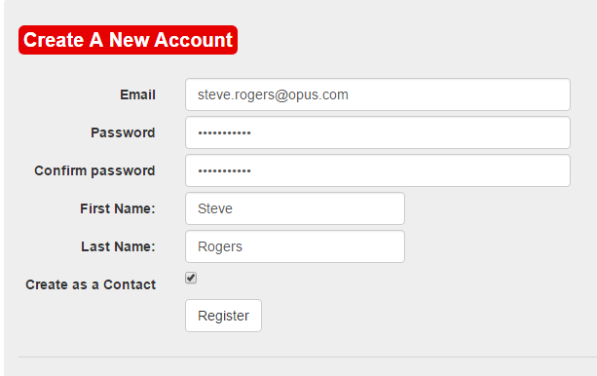
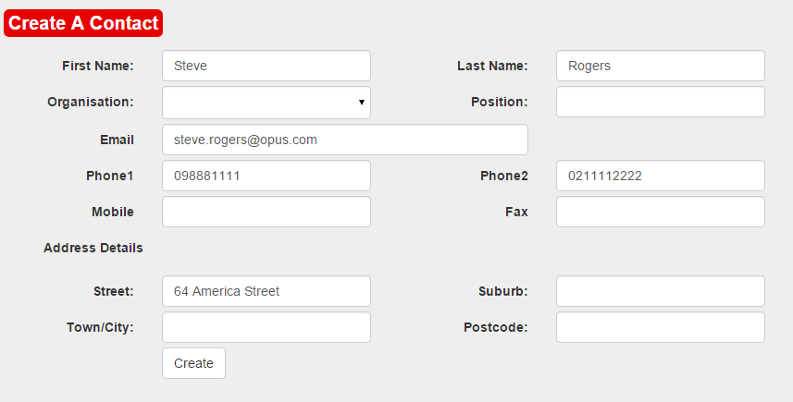
User/Contact Conflicts
Searches for User in the Contact table and populates form

Slide 12
Limitations
IT team were located in Christchurch
Was unable to obtain real data for testing
Incorrect permissions on Azure subscription

Slide 13
Evaluation
✔ Match between system and real world
✔ Consistency
✔ Error prevention
✔ Recognition rather than recall
✔ Aesthetic and minimalist design
✔ Help users to recognise, diagnose and recover from errors

Slide 14
Conclusion
A new OpusCOMMS system was created
Increased usability
Single system for both internal and external users
May be used within Opus in the future

Slide 15
Questions?
Thank you!

